Slide 1
Using HESI Data for Program Evaluation and Accreditation
Megan Ubben, MSN, RN, CPN
Senior Nursing Education Specialist

Slide 2
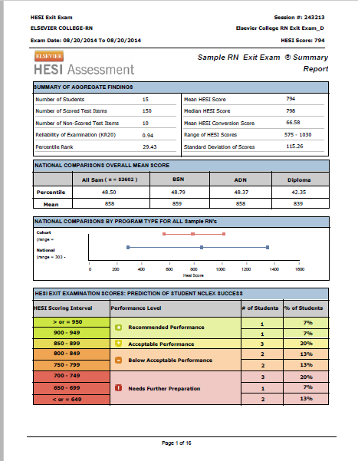

Are You Reviewing and Using Summary Analysis Data to Identify Trends over Time?

Slide 3
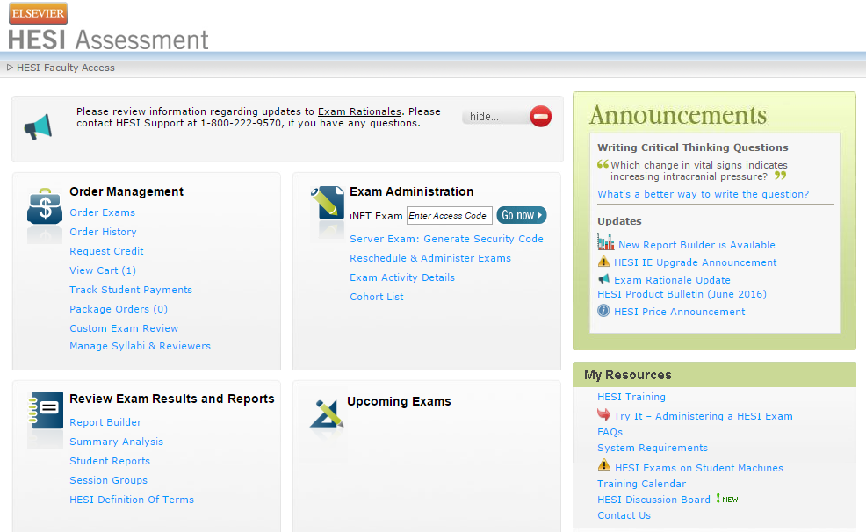
How Do I Trend Data?
Use the Report Builder
(HESI Faculty Access > Review Exam Results and Reports > Report Builder)
Watch the HESI Report Builder video
For a guide on how to build a trending report and export to Excel, see HESI: Trending Reports over Time (pdf) in the Related Documents section of the video associated with these slides

Slide 4
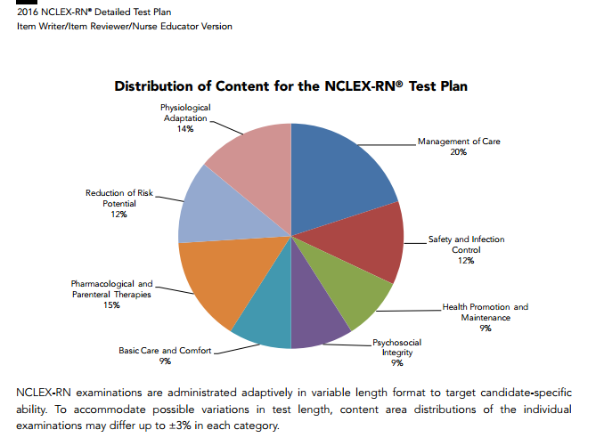
HESI Exit Exams Mirror NCLEX® Distribution of Content

Slide 5
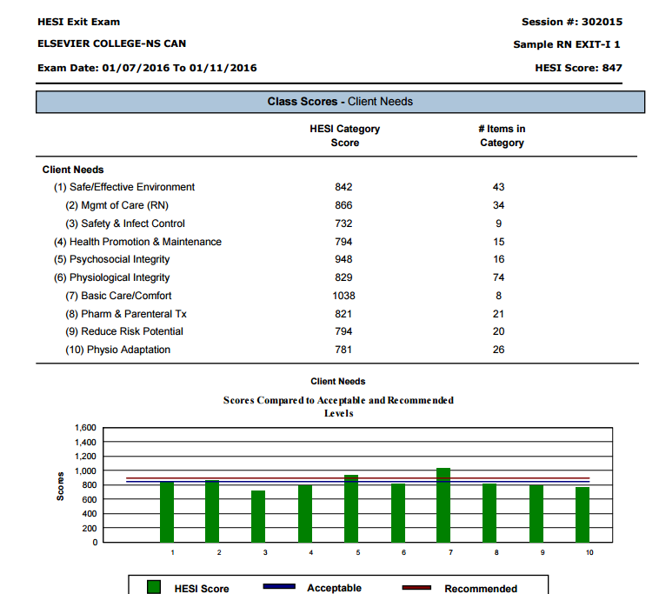
What Areas Should You Focus On?
HESI Exit Exams
Client Needs – NCLEX
Specialty and Sub-Specialty OR Concepts
These pages will help you evaluate the curriculum to identify strengths and potential curriculum gaps and areas of improvement

Slide 6
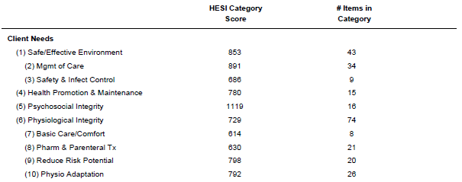
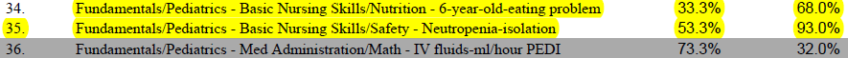
Looking at the Data

Slide 7

Prioritize Your Data
Strengths:
What 3 areas are students above benchmark?
Areas of Improvement:
What 3 areas are students below benchmark?

Slide 8
Additional Summary Analysis Data for Accreditation Reports
AACN Curriculum Categories
NLN Educational Competencies
QSEN Categories

Slide 9
HESI Exam Data Questions to Think About
How often should data be reviewed?
Who is responsible for trending data and identifying concerns and priorities?
How is data analysis documented?
How are action plans developed and implemented?
Where are action plans documented?
What is the process for re-evaluation?

Slide 10
Commit to a Continuous Quality Improvement Plan for Program Evaluation and Accreditation Using Your
HESI Data
Analyze data
Identify areas of improvement
Develop action plan
Implement action plan
Re-evaluate
Start process over!
Accreditation – The key is to document, document, document!

Slide 11
Megan Ubben, MSN, RN, CPN
Senior Nursing Education Specialist

