Slide 1
Using Evidence to Improve NCLEX® Pass Rates
Helen Murphy BS, RDMS, CHTS
eSolutions Implementation Consultant
h.murphy@elsevier.com

Slide 2
Steps to Success with HESI
Curriculum
Product Integration
Student Preparation
Remediation
Data Analysis
Policies
Notes:
We have found that schools that have succeeded in improving NCLEX pass rates while using HESI products have focused on some key themes in making their programs more successful. Using the data obtained from the HESI proctored exams is an objective way to identify consistent areas of weakness.

Slide 3
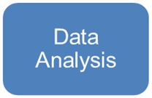
Data Analysis
Notes:
Focus on Data Analysis

Slide 4
Data Analysis
Determine the following actions
When should we begin to collect data
What details of the reports are reviewed
Frequency of collection
Who is responsible for collecting the data
What is communicated and to whom
Who is responsible for the follow-up
Notes:
Every exam students take in their courses and every test they take to prepare for the NCLEX should be viewed as an opportunity to collect data on their performances. (http://blog.examsoft.com/how-using-data-can-improve-nclex-pass-rates/)

Slide 5
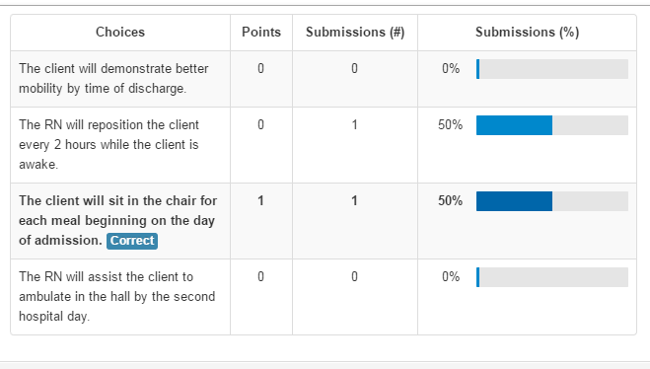
HESI Data Analysis Focus
Item Analysis
Using Item Analysis on all assessments will help to identify the areas where students do not have a complete grasp of the information presented
Notes:
To answer the question when should you begin to collect data – it is clearly with the first quiz, teacher made exam, homework assignment, case study, etc.

Slide 6

Frequency of Collection
Are you using Item Analysis after each assessment?

Slide 7
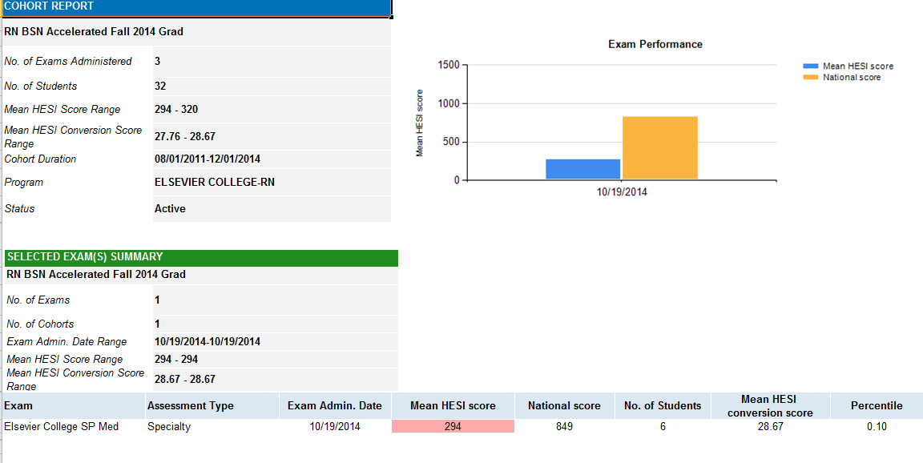
HESI Data Analysis Focus
Cohort Data – one point in time (cohort specific variables can affect data)
Notes:
What details of the report should be reviewed - Looking at Cohort Data gives you understanding on only one point in time. Keep in mind that there can be many variables that can affect that data, i.e. the cohort’s demographic makeup, academic ability, cognitive and behavioral factors.

Slide 8
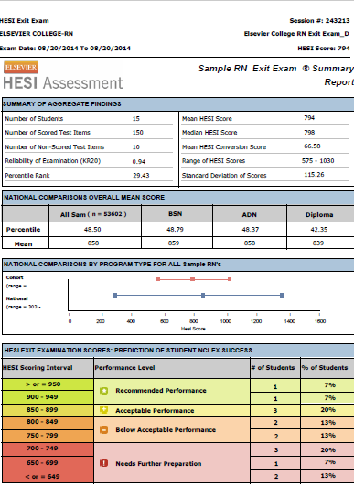
Summary Analysis Data
Reviewing the Summary Analysis Data after each HESI Exam to:
Identify Performance Level
Note Item Detail
Evaluation Scores –
Cohort vs. National
Notes:
However reviewing this data is important. Items to review:
Performance Level – Does the individual student score Correlate with students’ performance - are my students who do well are they doing well on the proctored exam and are my students who are not doing well not doing well on the proctored exam? – Do I have the traditional bell curve?
Item Detail – What did the test actually cover – Identifying the Specialty Area and Topic for each question asked
Scores – Cohort vs. National – On what questions is my cohort score greater than 10% less than the National Score

Slide 9

Frequency of Collection
Are you reviewing and using Summary Analysis Data after each HESI Exam?

Slide 10
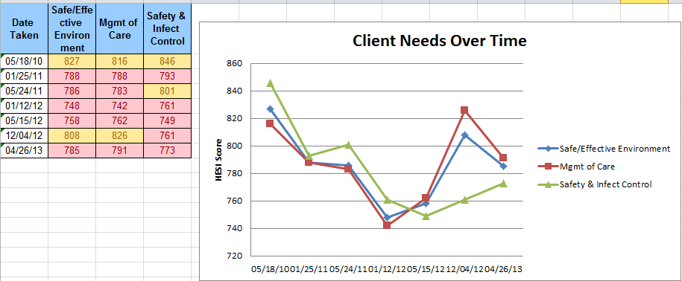
HESI Data Analysis Focus
Trending Cohort Data – identify ongoing patterns
Notes:
Trending Cohort Data allows you to see the ongoing patterns where the weaknesses and strengths can be easily identified.

Slide 11
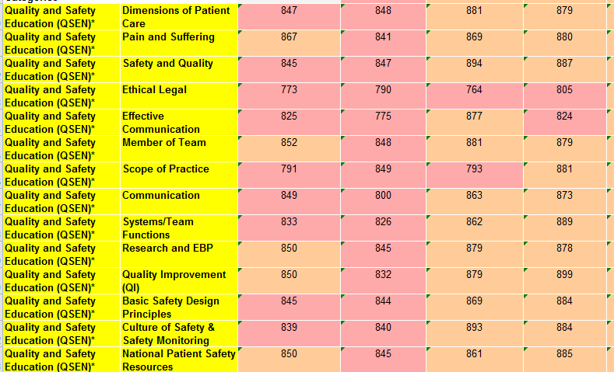
Notes:
Identifying consistent areas of weakness will allow instructors to know the areas of concern and will give instructors the opportunity to determine if there are curriculum changes that are needed.

Slide 12

Who Should Collect the Data
Who should be responsible for pulling the data?

Slide 13

Who Should Collect the Data
All Faculty should be responsible for collection of data
All Faculty should be prepared to discuss data at a regularly scheduled Faculty meeting

Slide 14

What Should Be Communicated
Data Review
Details
Responsible Party and Action
Communication and Follow-up

Slide 15
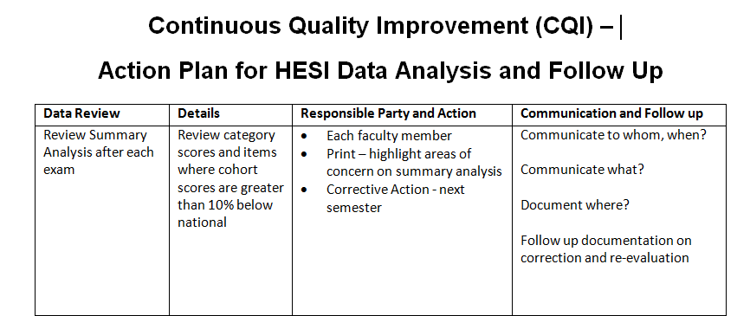
What Should Be Communicated
Developing a CQI (Continuous Quality Improvement) Document will identify all the specifics (an example is noted here)
Notes:
What data should be reviewed, what details of the data should be analyzed, who is responsible for analysis of the data and what action should they take and finally what should be communicated by whom and to whom and how should that information be documented. Finally documentation should be evaluated and any correction and re-evaluation should be identified and documented.

Slide 16

Follow-up
Using the data to identify areas of gaps and weakness
Develop a specific plan to address the gaps and weaknesses
Continuous follow-up will allow programs to find ways to improve the quality of the curriculum and instruction, which will ultimately improve NCLEX-RN® pass rates

Slide 17
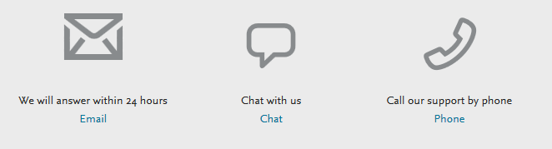
Additional Questions
Select one of the options below in the Evolve Support Center

