Slide 1
Talking to Students About Their HESI Results
Cami Weber, MSN-Ed, MBA, RN, CHSM
Nursing Education and Assessment Consultant
Notes:
Hello! Welcome to the discussion today about how to successfully discuss HESI results with your students. My name is Cami Weber. I am a nurse educator working for Elsevier. Today’s discussion is not intended to show product navigation or functionality. Please refer to our On Demand and Training & Implementation website for functionality information at https://evolve.elsevier.com/education/on-demand-learning.

Slide 2
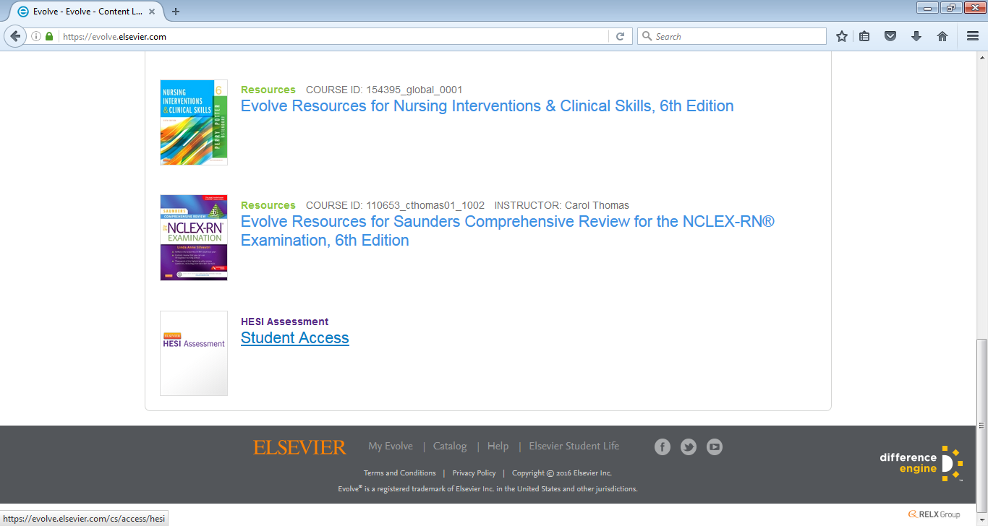
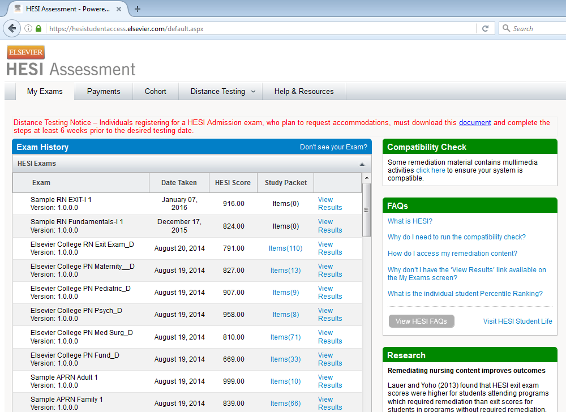
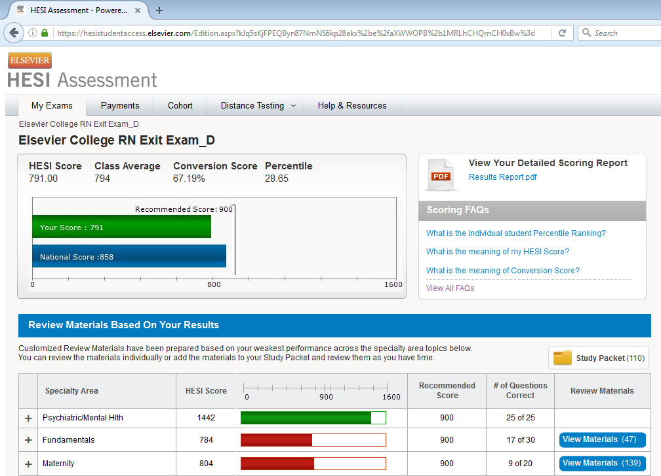
Student HESI Reports
Notes:
One thing that I think is important for faculty to know is that students have access to their own student reports. There is no need for you to print them out for students. When students login to their HESI Student Access (where they go view their online HESI remediation), they can access the reports for each HESI exam they have taken. It’s also important to note that students have access to their online HESI remediation & reports for life. This access never goes away. All they need to do is login to Evolve. Their password does not expire.

Slide 3
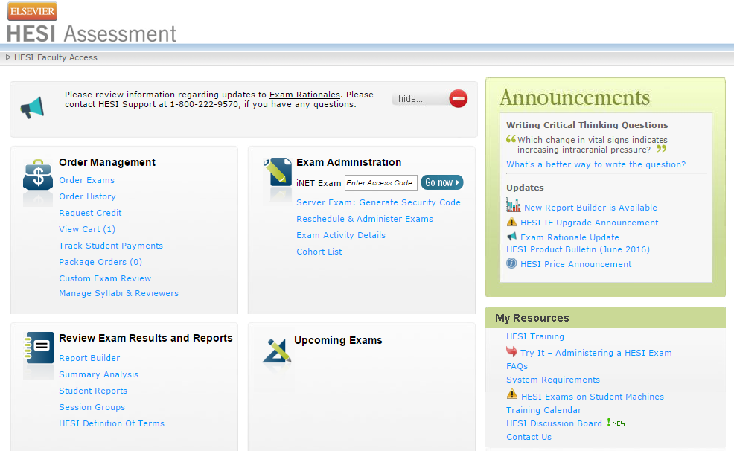
Faculty Access to Student Reports
Notes:
As faculty, you can access each student’s report by selecting Review Exam Results and Reports > Student Reports below the Summary Analysis report.

Slide 4
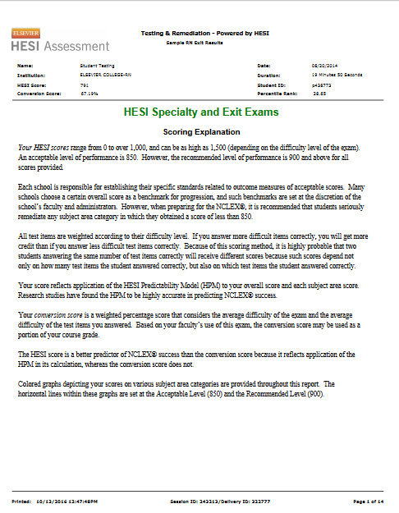
Scoring Explanation
Notes:
First let’s talk about when/why faculty would look at an individual student’s report. Most of the time as faculty we just focus on the Summary Analysis or Cohort report. Usually, faculty only need to bother looking at the details of an individual student report if they need more specific information on a student or if they are working 1:1 with a student.
However, it is important that all faculty know how to interpret the student data. If you already know how to interpret the Summary Analysis data then interpreting the student reports will be no problem. The flow and information is essentially the same; however, you do want to educate yourselves, so you can educate your students. It is very important that students understand how to interpret their own results and take accountability for their own learning.
One great tip I have learned is to require all students to bring a printed copy of their student report to class with them after they have taken their HESI exam (some faculty use this as a ticket to class). This is especially valuable in the beginning with the first few HESI exams they take. This let’s you know that they know how to access their own report.
Next, spend sometime explaining to them what they are looking at and how to interpret the data. Help them identify their 2-3 weakest areas. Explain the Client Needs categories and why this information is important, because it is the NCLEX test plan. Help them understand what the NCLEX test plan is and where they can locate the test plan for students on the NCSBN.org website. Speak about HESI & NCLEX in a positive light. Explain that HESI follows the flow of NCLEX. Also, this is a great time to discuss remediation requirements and why remediation is so valuable as a key to their success.
This is the first page of the student’s report. It explains the scoring of HESI. It also explains the conversion score. Most students never bother to read this page, but I would require all students to spend a few minutes reading the information on this page.

Slide 5
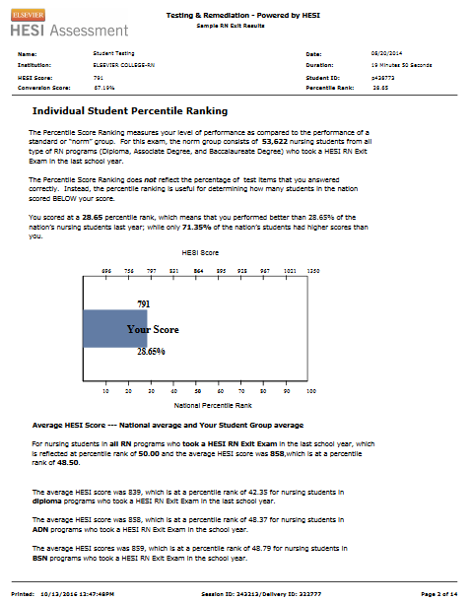
Percentile Ranking
Notes:
Page 2 explains their percentile ranking. This is a ranking of how the individual student performance compares to other nursing students’ performance nationally. It doesn’t rank them based on the percentage of test items they scored correctly for this exam.
For example, with this particular exam shown, this student scored 28.65%, which means they performed better than 28.65% of the other students nationally last year, while 71.35% of the students scored higher than this student.

Slide 6
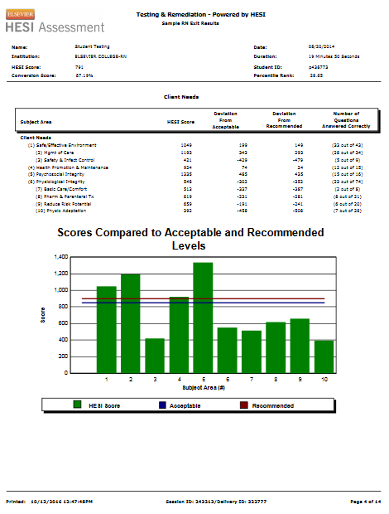
Client Needs
Notes:
Here you see the Client Needs categories displayed and how this particular student performed in these areas. First, you have the HESI score for each area. You will see how many questions were available and how many were answered correctly. Below that you will see the visual bar graph. The green bars demonstrate the student’s score.
It’s important to teach students to pay attention to the number of testing items in a particular area. The more items being tested, the more significant the results.

Slide 7
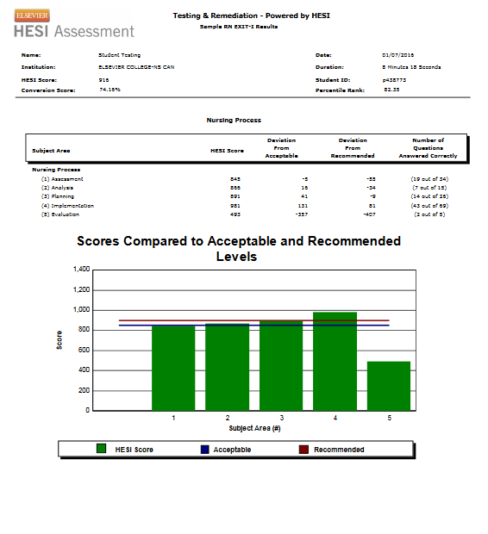
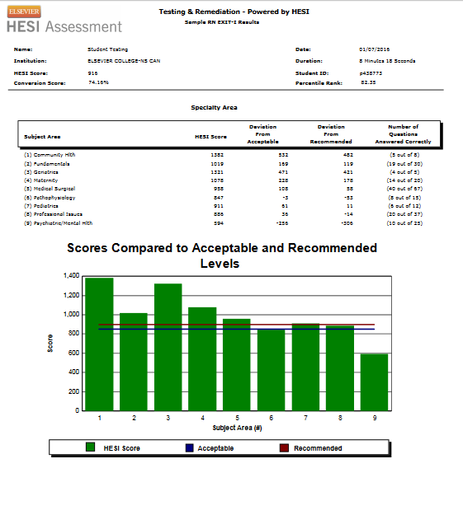
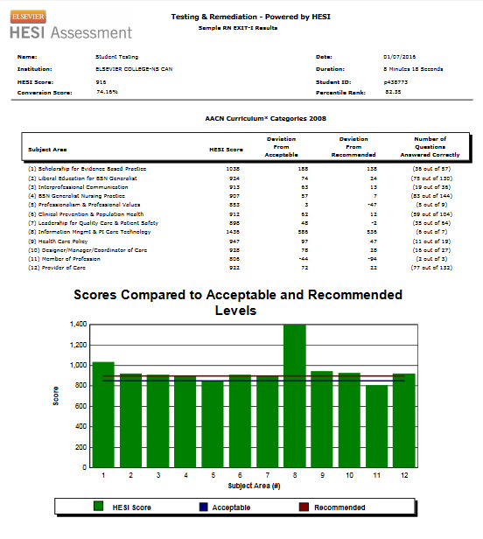
HESI Student Report
Notes:
As you will see the report continues in the same manner, breaking down each category and subject area. Students will always see their numerical values at the top and the bar graph displayed at the bottom.
Again, help students to identify their 2-3 areas of weakness. It’s too overwhelming for them to try and address every area below the benchmark score. In the beginning students will need help from faculty to identify these weak areas. Over time, they will become used to reading the reports and what to look for, although, faculty reassurance is helpful.

Slide 8
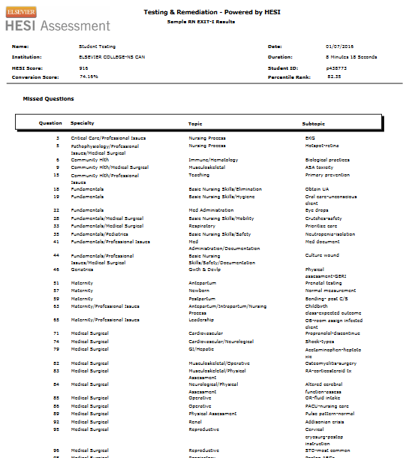
Missed Questions
Notes:
Lastly, students will see the Specialty area and Topic area for the items missed. Notice the big “X” over the Subtopic information. The Subtopic data is no longer available to students in their reports. This was giving students too much information and they were focusing too much on the particular Subtopic when remediating, thus, causing them to skip valuable concept information. We want students to focus on the Topic or Concept areas instead.

Slide 9
HESI Resources
Resources for Students:
Elsevier Student Life - https://evolve.elsevier.com/studentlife
HESI Exam Tutorial - https://hesiinet.com
HESI FAQs - https://evolve.elsevier.com/education/on-demand-learning
Resources for Faculty:
HESI Training - https://evolve.elsevier.com/education/on-demand-learning
Notes:
Keep in mind that students & faculty have a lot of HESI resources available. The Elsevier Student Life resource has a lot of valuable information for students and faculty. heck out the other resources available.

Slide 10
Cami Weber, MSN-Ed, MBA, RN, CHSM
Nursing Education and Assessment Consultant
Notes:
I hope you enjoyed this discussion. I wish you well as you work to help your students understand their HESI results.

