Slide 1
Student Success and Engagement with HESI
Cami Weber, MSN-Ed, MBA, RN, CHSM
Nursing Education and Assessment Consultant
Notes:
Hello! Welcome to the discussion today about how to get students engaged with HESI for successful outcomes. My name is Cami Weber. I am a nurse educator working for Elsevier. Today’s discussion is not intended to show product navigation or functionality. Please refer to our On Demand Training and Implementation website for functionality information at https://evolve.elsevier.com/education/on-demand-learning.

Slide 2
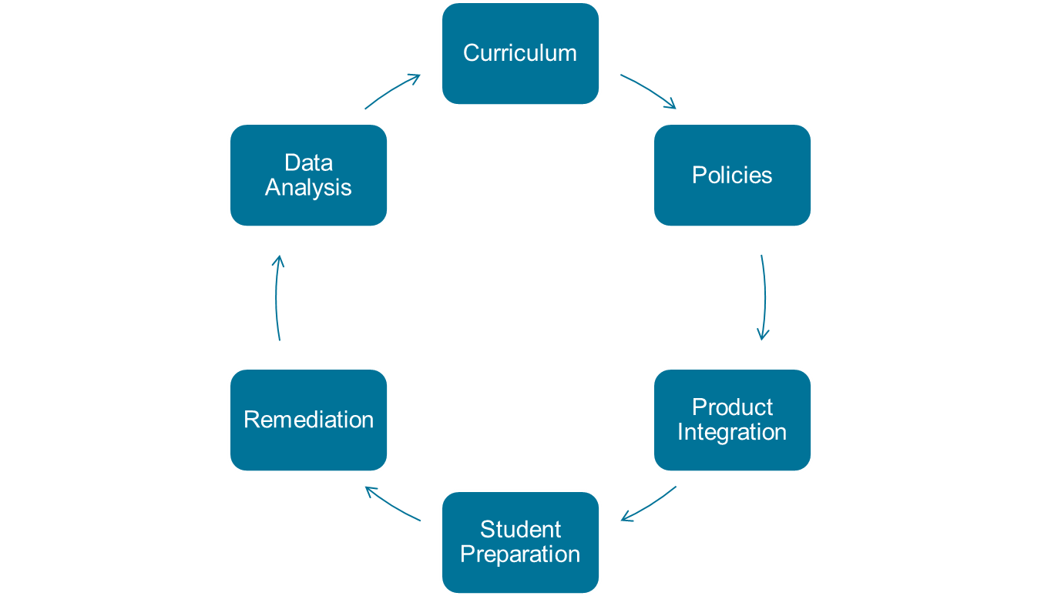
Six Steps to Success with HESI
Notes:
First let’s talk about the necessary steps that makes HESI successful. HESI alone cannot make your program successful. It requires all of these components working in tandem to produce successful program outcomes. Student engagement is one of the key outcomes to this process.
This successful process begins with a strong and updated curriculum, testing and remediation policies that are followed and is a program expectation for all. Proper integration of your HESI products (HESI Case Studies/Practice Tests and EAQ) or any other prep/remediation tools you may be using, equipping your students with all the necessary information needed to prepare for HESI through the classroom, lab and clinical, required student remediation that holds students and faculty accountable for completing remediation, and finally data analysis. As faculty we owe it to our students to let them know that were are looking at the data and what we are doing with it.

Slide 3
Student Engagement and Preparation
Begin early discussions about HESI and NCLEX
Be positive
Be informative and open
Do your research so you can conﬁdently answer questions
Know the resources and how to access them
Elsevier Student Life - https://evolve.elsevier.com/studentlife
HESI Exam Tutorial - https://hesiinet.com
Evolve HESI Support - https://service.Elsevier.com/app/overview/evolve
+1 800 222 9570
Notes:
Often students think of HESI as a very scary exam—one that is impossible to study for. Sometimes students go through their entire nursing program not really understanding what HESI is, why it is necessary or what exactly NCLEX is. I know of students who had no idea they had to take a licensure exam at the end of their program. None of this should be the case. Faculty need to begin the discussion early on in the program, even before students are officially accepted to the program. Many students come for tours and meet with faculty when they’re making their decisions about what college to attend. The discussion should begin with the initial campus visit and move on to orientation, followed by discussions in every course.
However, it is important to remember these conversations should remain positive. The message conveyed should be that HESI is a tool that will help them know their areas of weakness and will help them be better prepared to pass NCLEX.
Again, keep the discussions positive and explain all they need know about the exams. There should not be any surprises. Be open with your information. Students look to their faculty as positive role models and value what you think is important. If you talk negatively about HESI exams or NCLEX, students will begin to devalue the importance of these exams and will not take them seriously. Students who view HESI as important are likely to score higher than students with negative feelings.
As faculty, it is your job to know the available HESI resources so you can confidently answer students’ questions and guide them to the resources available to them. Here are three very important resources for students. Faculty should be aware of what these resources offer and how to access them.
Elsevier Student Life
HESI exam tutorial
HESI Support

Slide 4
HESI Tools
Exam Prep Tools
HESI Case Studies*
HESI Practice Tests*
HESI Patient Reviews
Elsevier Adaptive Quizzing (EAQ)*
HESI Exams (proctored)
Specialty
Custom
Exit
Student Remediation
HESI Online Remediation
HESI Case Studies
HESI Practice Tests
Elsevier Adaptive Quizzing
HESI Data
Student Reports
Summary Analysis Reports (cohort data)
Resources for Faculty
Elsevier Student Life
Evolve Support, Tutorials, FAQs
HESI Training - https://evolve.elsevier.com/education/on-demand-learning
* Can be used in remediation.
Notes:
This slide is showing all of the HESI tools that are available to you. You will only have access to what your school has purchased. If you are unsure what tools your school has, a good place to start is with your campus administration to understand the tools available to you and your students.
Here I have listed the HESI Case Studies, Practice Tests, Patient Reviews and EAQ as both prep tools and remediation tools. For the purposes of this recording I am going to assume you have purchased all of these products. I encourage you to use all of the tools available to you. Using the HESI CS/PT will help your students become more familiar with they types of questions they will see on a HESI exam. Since the questions are written in the same manner as the proctored HESI exam questions, students will feel more at ease when taking their proctored test because they will recognize the writing style. It makes sense that the more exposure students have to similar questions, the better they will do on their proctored exams. There is published HESI research that shows students have an increase on their proctored HESI exams when they complete the HESI Case Studies. Too often I work with schools that don’t take advantage of these wonderful tools. Don’t let that be you.
However, do check with your administration to see if you have a policy on how your school has decided to implement these products in your program. For more information and best practices on product integration, refer to the Training and Implementation website for further information at https://evolve.elsevier.com/education/on-demand-learning.
Here again is a list of resources. It is imperative to know what and where your resources are. I encourage you to review each one of these for yourself as the information is constantly updated. Again, knowing your resources will increase your confidence level when discussing HESI with your students. They will become more engaged with the more you know.

Slide 5

Consequences and Remediation
Consequences
What’s in it for me?
It needs to be worth my time.
Why is this important in Ms. Smith’s class, but not yours?
Remediation
Why is this important?
It seems like busy work.
How long will this take me?
What’s in it for me?
How are you going to make me do it?
Notes:
Another very important piece to student success and engagement with HESI is to have exam consequences and remediation requirements. Think like a student. If students are not getting some benefit or some reward for taking the proctored HESI exam, they simply will not take them seriously. Students want to know what’s in it for them: “How is this worth my time?”
Having a consequence will also make your HESI data more reliable and valuable. Your data is only as good as the students taking the exam, meaning if students don’t try and don’t care what results they get, your data will not be a true reflection of the ability of your students. You will likely see very low exam scores.
Also, there must be consistency across the program! Students should be able to go from one course to the next and know exactly what the expectations are of them. Each faculty member must have the same grading and remediation requirements. Students want to know what the rules are. Knowing the rules removes any questions or doubts about the exam. It helps to decrease student anxiety and creates a more positive environment.
Lastly, you can increase student success and engagement through remediation. Through some of our HESI research we have found that when students have consequences and remediation requirements, you will see an increase in their HESI scores. In order to make remediation valuable through the eyes of the student they must have an understanding of exactly what is expected of them. Many students will view remediation as busy work unless there are clearly outlined expectations, ad, they must be held accountable for completing their remediation.

Slide 6

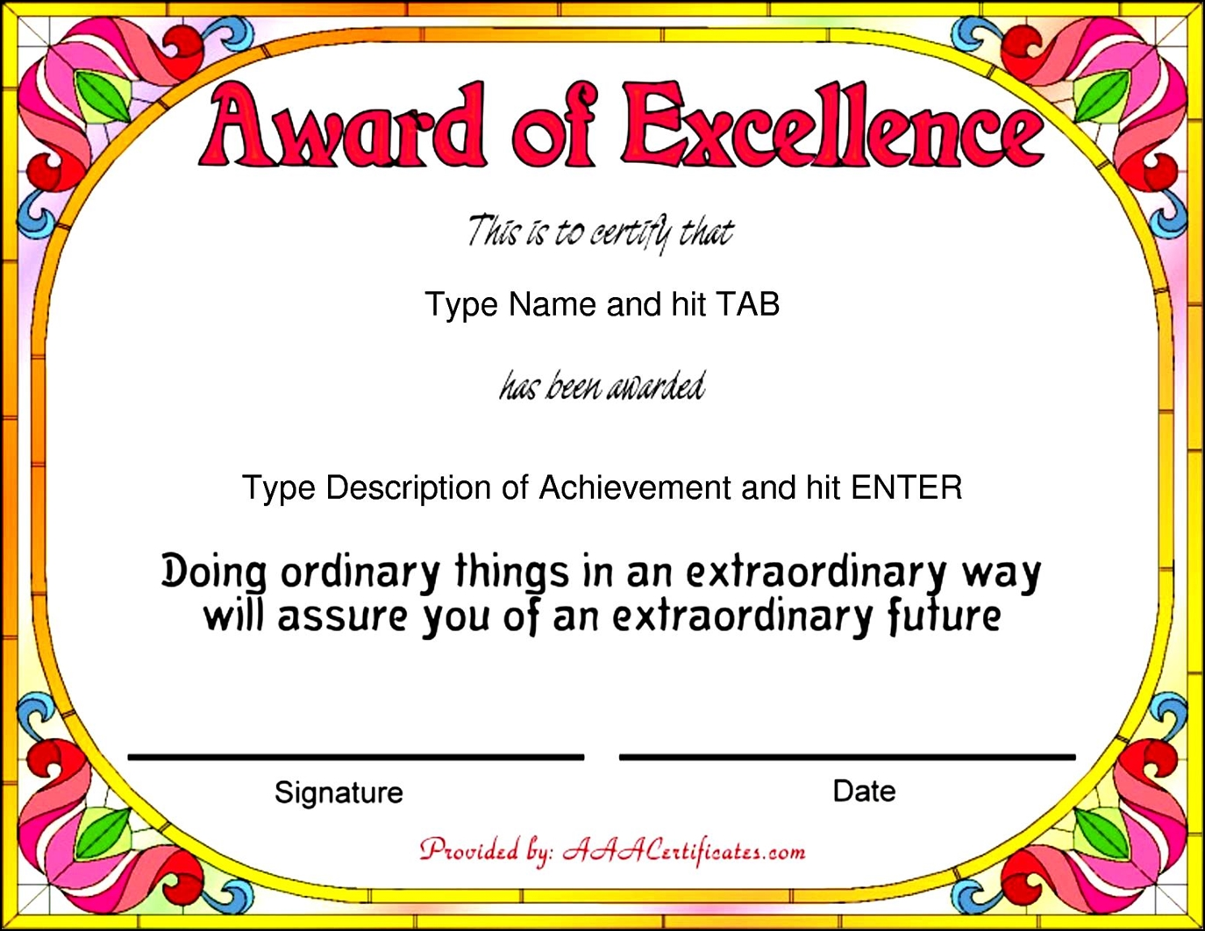



Notes:
Lastly, another tip for increasing student success and engagement with HESI is to offer rewards for good scores. By good scores I am referring to students that achieved your set benchmark score or higher. I have worked at schools that offer a rewards program and it is amazing how simple and effective this is.
Think back to your kindergarten days and how excited you were when your teacher recognized your excellent work with a sticker or smiley face on your paper. It was always exciting when your name was put on the bulletin board because of something you did well. It’s amazing how the same feelings are true of adult college students. They love special recognition. Sometimes it’s the simple things that mean the most.

Slide 7
Cami Weber, MSN-Ed, MBA, RN, CHSM
Nursing Education and Assessment Consultant
Notes:
I hope you enjoyed this discussion. I wish you well as you find ways in your program to increase student success and engagement with HESI.

