Slide 1

NCLEX Detailed Test Plan and HESI Testing:
A Perfect Match!
Tammy Pleasant, MSN, RN, CNE,
Digital Product Educator
Created 2016.
Revised: Donna Walls, PhD, RN, CHSE, Director, Digital Product Education 7 Consultation, 08/25/2017
Notes:
Hello, My name is Dr. Donna Walls. I am the Director of Digital Product Education and Consultation for Elsevier. This short video is revised from a previous video written by Tammy Pleasant in 2016. The title of this video is …

Slide 2
Objectives
Following this presentation, the participant will be able to:
Correlate HESI student data and cohort data with NCLEX Test Blueprint
Facilitate improved student outcomes by using the NCLEX Detailed Test Blueprint along with HESI data to drive learning in classroom and clinicals
Notes:
Following this presentation, and upon implementing these suggestions, the participant will be able to:

Slide 3

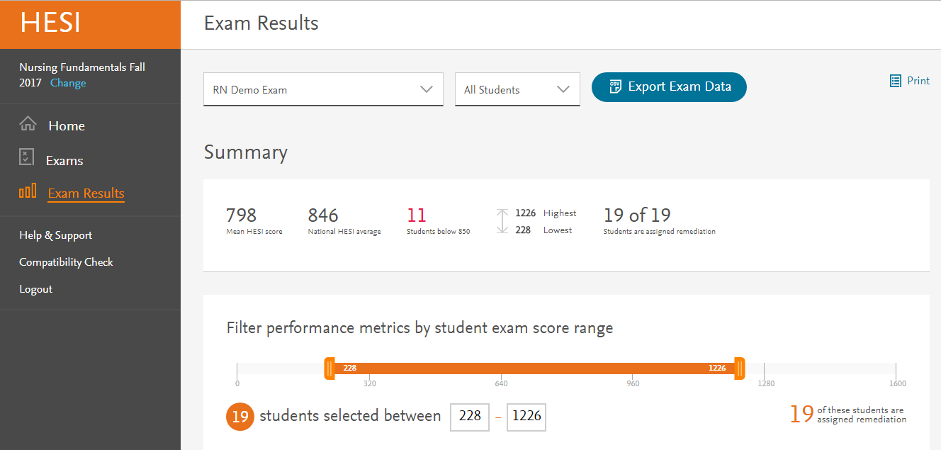
https://www.ncsbn.org/2016_RN_DetTestPlan_Educator.pdf
Summary Analysis
Report Builder
Readily-available student data
Notes:
Let’s talk briefly about the NCLEX-RN test plan and then HESI Reports. As an educator, I understand the importance and value of faculty familiarizing themselves with the NCLEX test blueprint and making sure that their students are aware of these Client Needs categories. With HESI, you will see how your cohort has performed in these Client Needs categories in the Summary Analysis, or within the readily available student data found in the Dashboard for HESI next generation, and within the Report Builder, where you can actually trend data over time.

Slide 4
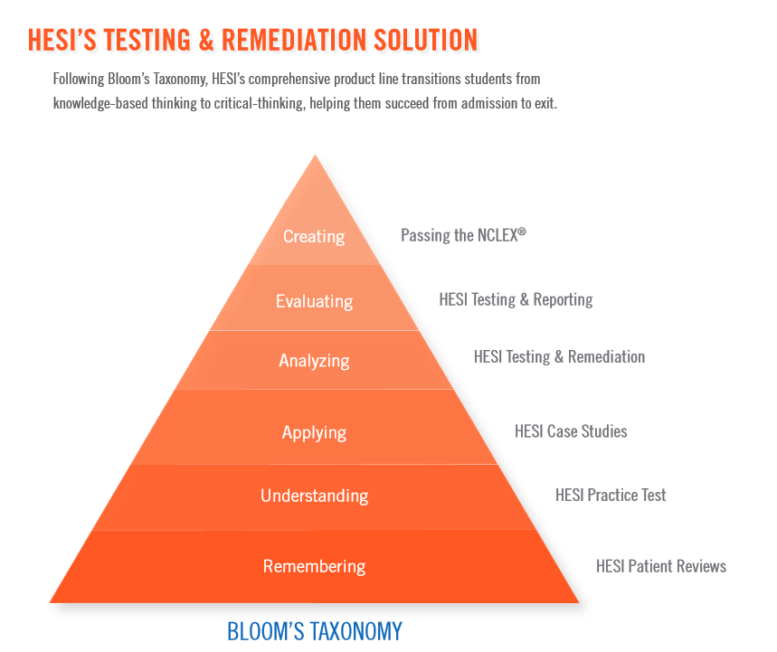
HESI AND NCLEX: APPLICATION AND HIGHER COGNITIVE LEVELS!
NCLEX
TEST
BLUEPRINT
Notes:
NCSBN says this about the NCLEX items: Classification of Cognitive Levels – Bloom’s taxonomy for the cognitive domain is used as a basis for writing and coding items for the examination (Bloom, et al., 1956; Anderson & Kratwohl, 2001). Since the practice of nursing requires application of knowledge, skills, and abilities, the majority of items are written at the application or higher levels of cognitive ability, which requires more complex thought processing. (2016 NCLEX-RN Detailed Test Plan; Nurse Educator Version)
HESI follows suit and write questions at these same levels, even in the Case Studies and Practice Test products.

Slide 5
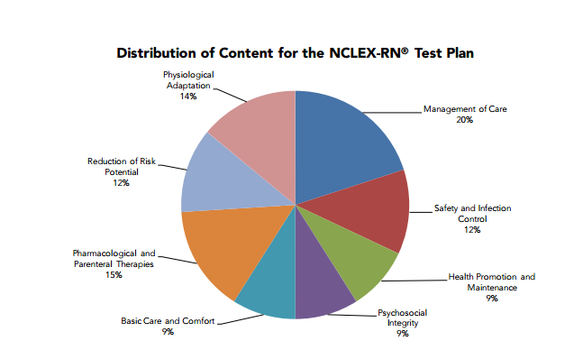
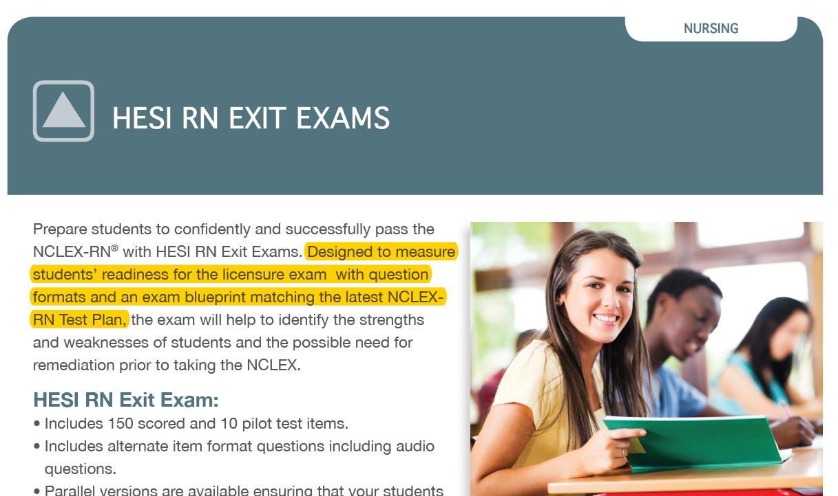
2016 DETAILED TEST PLAN
(2016 NCLEX-RN Detailed Test Plan; Nurse Educator Version)
Notes:
If we look at the 2016 Detailed Test Plan, you will see the breakdown for each of the Client Needs categories. The EXIT exam is built on this exact same blueprint. For example, the Detailed Test Plan identifies that Management of Care will be 20% of the exam, therefore HESI will have 20% Management of Care items on the Exit Exams.

Slide 6
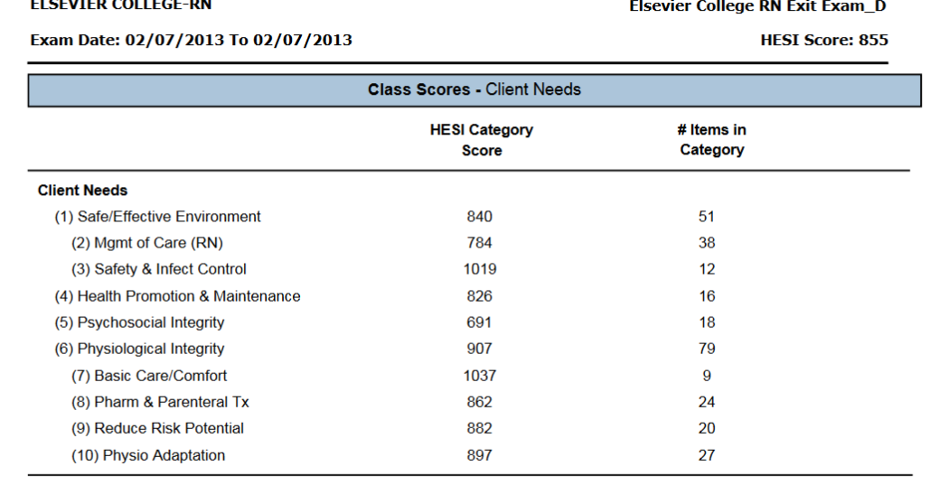
Review Summary Analysis Report: Client Needs Categories
NCLEX TEST BLUEPRINT- “The framework of Client Needs was selected for the examination because it provides a universal structure for defining nursing actions and competencies, and focuses on clients in all settings.”(2016 NCLEX-RN Detailed Test Plan; Nurse Educator Version)
Notes:
Let’s look at the Summary Analysis Report and make the connection. Remember that for HESI next generation, you will see these scores right on the Dashboard! From the NCLEX Test Blueprint, you see a direct quote that tells us … In this example, you will see that, for that 20% chunk of Management of Care items, the students had 38 questions on this Exit Exam and scored pretty low – 784. This is really important information for the educators of this cohort! At the same time, they need to know that the students did really well in the Safety and Infection Control section, even though it was a small portion of the examination.

Slide 7
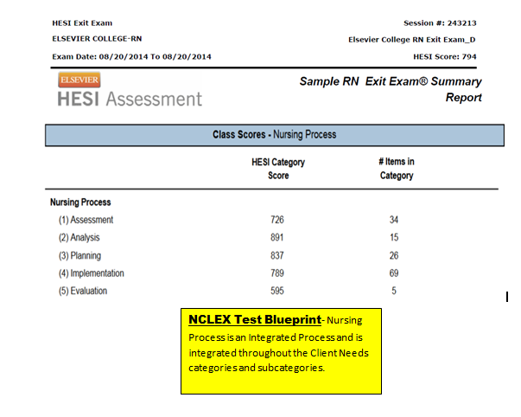
Summary Analysis: Nursing Process
Notes:
We can also look at the scores for Nursing Process. This will be found in the Summary Analysis or on the Dashboard for HESI NG users. With the NCLEX blueprint the Nursing Process is considered an integrated process. Looking at this report, I would see that my students scored a 595 in Evaluation. There were not a lot of questions in this area, but I would still want to consider this as a weakness for this cohort. In Assessment, there were 34 questions and the students scored low. We know this is very important, so I would want to dig into it and find out where the gaps might be within the curriculum.

Slide 8
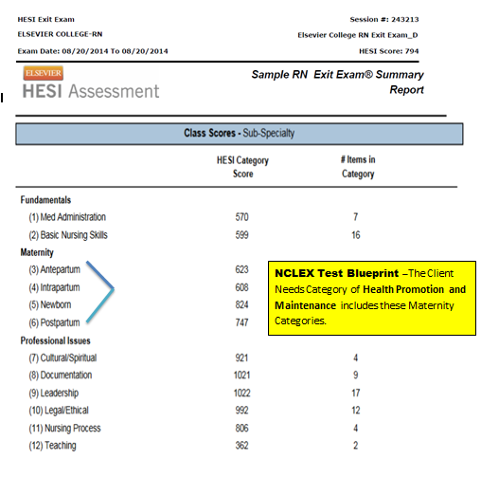
NCLEX TEST BLUEPRINT – Med Administration would fall under Physiological Integrity/Pharmacological and Parenteral Therapies.
NCLEX TEST BLUEPRINT – Leadership and Legal/Ethical would be in the Client Needs Category of Safe and Effective Care/Management of Care
Notes:
When looking at the specialty categories, we can identify where each of the specialty categories might be found within the NCLEX Blueprint.

Slide 9
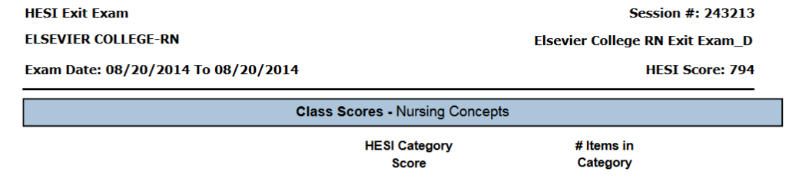
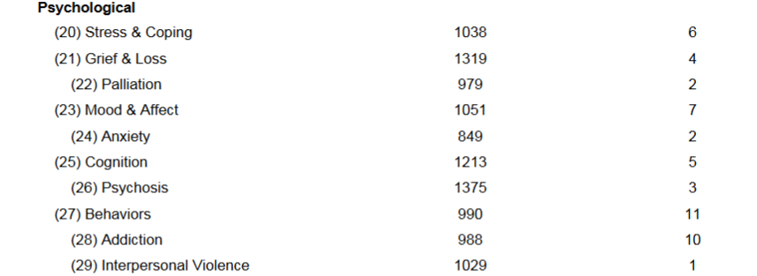
Dig Further to see the Practice Analysis Activity Statements Reflected in HESI Testing
NCLEX TEST BLUEPRINT
Client Needs Category – Physiological Integrity
Subcategory- Physiological Adaptation
Activity Statement- “Manage the care of the client with a fluid and electrolyte imbalance.”
NCLEX TEST BLUEPRINT-
Client needs Category – Psychosocial Integrity
Activity Statements
“Assess client in coping with life changes and provide support”
“Provide end of life care and education to clients.”
“Provide care and education for acute and chronic psychosocial health issues.”
“Provide care for a client experiencing visual, auditory or cognitive distortions.”
“Assess client for drug/alcohol dependencies, withdrawal, or toxicities and intervene as appropriate.”
“Assess client for abuse or neglect and intervene as appropriate.”
Notes:
We can also correlate what is seen in the data with the activity segments in the Detailed Test Plan. Looking at the Class Scores – Nursing Concepts. Within the NCLEX blueprint, this is the physiological Integrity category, but in the Activities Statements, you will see actual supportive activity statements. For fluid and electrolytes, one acftivity statement is, “Manage ethe care of the client with a fluid and electrolyte imbalance.” This could guide you to plan clinical or simulation activities. For these Psychological Concepts, NCLEX give us some concrete activity statements to help us direct teaching. Note that these are Application activities! …

Slide 10
Using This Perfect Match to Improve Student Success – Step ONE – Use what you have!!
Direct students in their first nursing class to the NCLEX Detailed Test Plan: Candidate Version
Keep a copy of the Detailed Nurse Educator Version on hand and refer to this in all that you do.
(https://www.ncsbn.org/2016_RN_Test_Plan_Candidate.pdf)
(https://www.ncsbn.org/2016_RN_DetTestPlan_Educator.pdf)
Notes:
We can make a direct correlation between the HESI data provided by the exams and the NCLEX blueprints. So, let’s use what we already have available to us!!
I would like to make a brief note for your information: Every three years, the NCLEX exam changes. HESI responds to this change in January before the changes are actually implemented in April.
First of all, we suggest that every student should be made aware of the student version of the detailed test plan. In many schools, the students are asked to print it and bring it with the to classroom, where faculty help them to understand it and study with it.
Then, faculty should use the detailed test plan to help them in all that they do! – in classroom, clinical, simulation lab, and in post-clinical conference.
Here are some ideas for faculty:
Planning classroom and clinical lessons
Writing test items for faculty made exams
Reviewing student performance on HESI exams
Review of curriculum

Slide 11
Using This Perfect Match to Improve Student Success – Step TWO – Follow the data!!
  When analyzing your HESI Exam data, use the Client Needs Category to help evaluate student performance.
  Use this data to help prepare students and as one method of student remediation.
Notes:
When analyzing your HESI Exam data (Summary Analysis or special reports from Report Builder) identify the specific Client Needs Categories and related subcategories and activity statements, and evaluate your students’ performance in these areas. This allows you to individualize your remediation and planning around this particular cohort of students. For specialty exams, the information can be passed onto the next semester so the faculty can work to improve the weaknesses. For the exit exam, the weak areas can be easily identified and used as part of the remediation.
As you can see this correlation between the HESI data and the NCLEX Blueprint is HUGE and is truly the PERFECT MATCH to ensure student success!

Slide 12
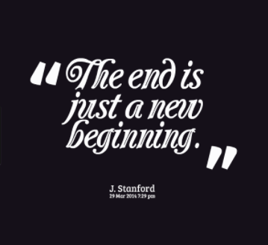
Notes:
Now you know… what will you do with this information??
Thanks for attending and I wish you a very successful semester!

